Slide 1

Data Visualization Presentation
Rekha Rekha

Slide 2

Introduction
Hello Everyone
In this presentation I will take you through our company’s sales performance for the years 2010 and 2011.
I hope you find the analysis compelling and helpful as you make decisions regarding your future business requirements.
Cleaned and Prepared the dataset to ensure it's well-organized for effective visualization.
Notes:
Thank you for the opportunity you gave me to dive into this data to gain insightful information about the online store’s performance.
I cleaned up the data by removing all the negative values in th eunit price and quantity columns and filtered the records to provide helpful analysis and visualization.

Slide 3
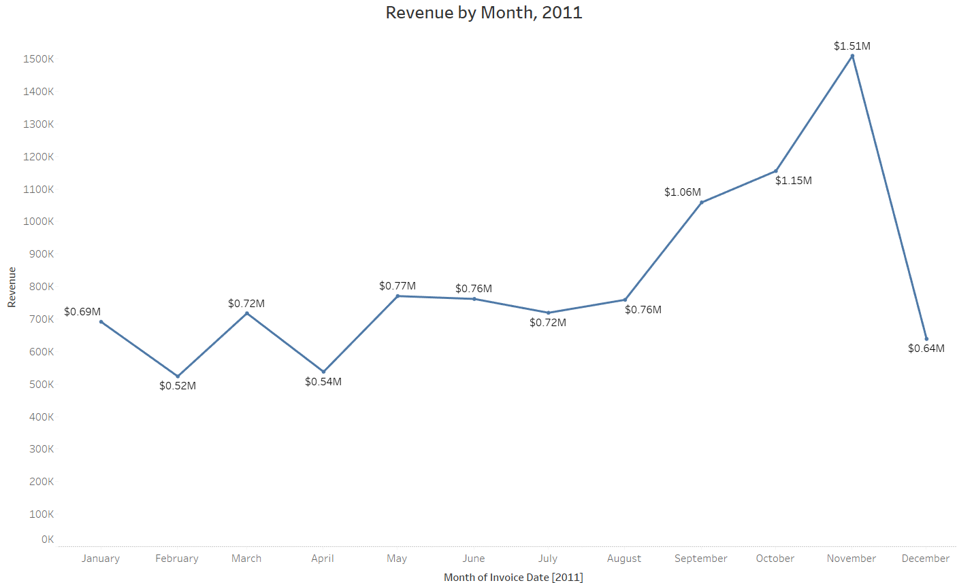
Revenue by Month in 2011
The store see consistent growth in first 8 months with avg of $685k.
However, from September onwards there is significant surge, peaking at $1.5m in November and an avg of 21.18% increase in revenue from August to December.
The revenue trend from August to December demonstrates how seasonality affects retail store sales.
Sudden drop in December revenue because of insufficient data.
Notes:
The store see consistent growth in first 8 months with avg of $685k.
However, from September onwards there is significant surge, peaking at $1.5m in November and an avg of 21.18% increase in revenue from August to December.
The revenue trend from August to December demonstrates how seasonality affects retail store sales.
Sudden drop in December revenue because of insufficient data.

Slide 4
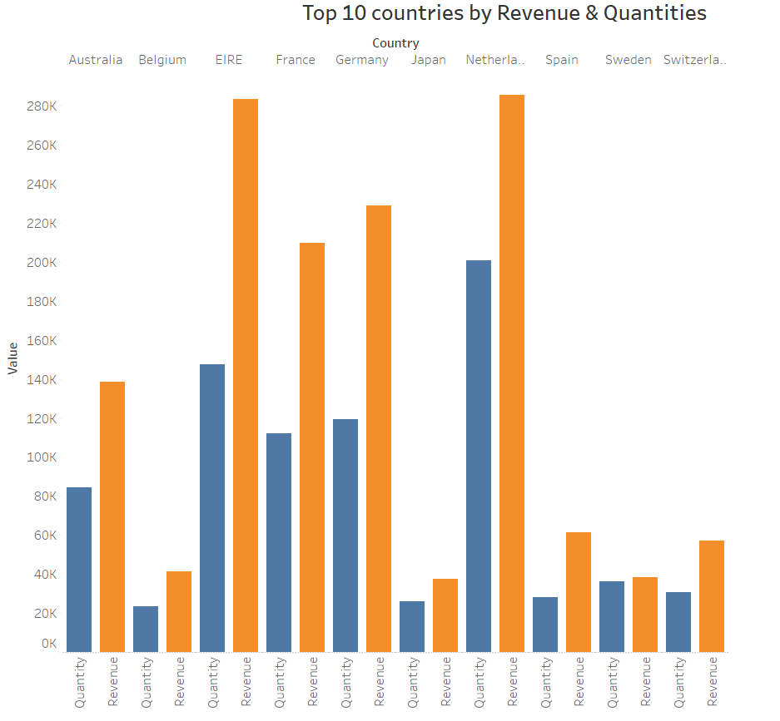
This chart represent the top 10 countries by Revenue and Quantities except the UK. Notably, countries like Germany Netherlands, Ireland and France show high volume of units and revenue. To maximise these opportunities, a marketing strategic focus on further capturing demand in these regions is recommended.
Top 10 Countries by Revenue and Quantities
Notes:
This chart represent the top 10 countries by Revenue and Quantities except the UK. Notably, countries like Germany Netherlands, Ireland and France show high volume of units and revenue. To maximise these opportunities, a marketing strategic focus on further capturing demand in these regions is recommended.

Slide 5
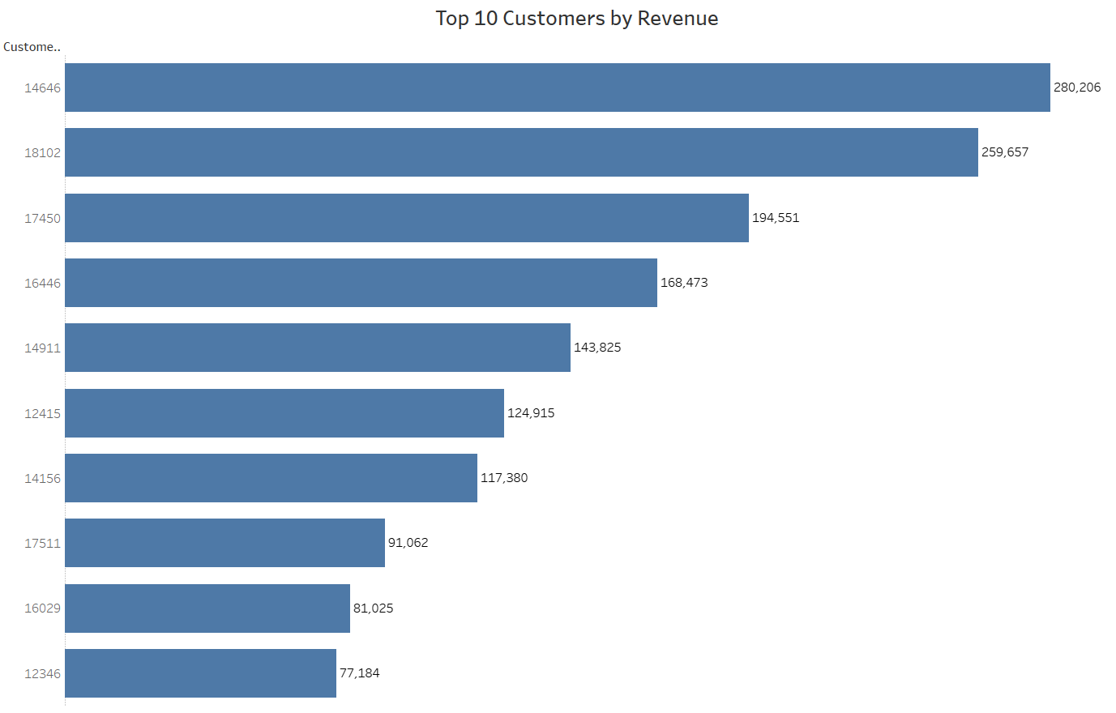
Top 10 Customers by Revenue
The purchasing patterns of the top 10 customers appear balanced.
The highest revenue-generating customer only purchased 8% more than the second highest and total avg difference of 15.8% indicating a diversified customer base and a favorable business position.
The company can aim to strengthen the relationship with these customers to increase customer loyalty, retention and ultimately drive more sales and revenue for the company.

Slide 6
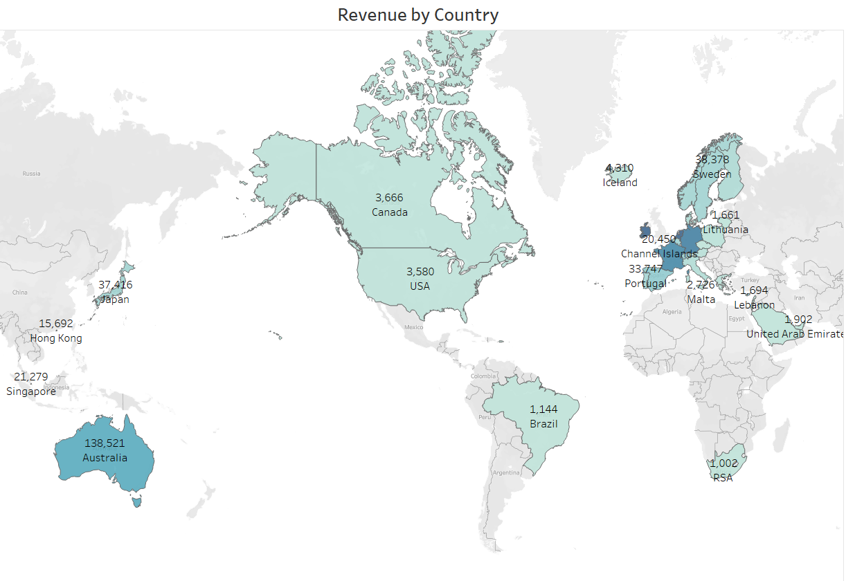
Revenue by Country
The map chart highlights regions with significant revenue generation, emphasizing the need for increased investment.
Countries like Netherlands, Irelands, Germany, France and Australia stand out.
While regions like Africa, Russia and parts of the Americas show lower demand.
The company should prioritize the European market, developing targeted strategies for each country in the region, along with Australia and Japan, to maximize sales.

Slide 7
Pointers
The company should develop plans to stock and promote seasonal products, aiming to boost sales during peak demand periods for these items.
The company should do a deeper analysis of products that are usually in high demand during low sales months to come up with strategies for marketing these products.
Taking a closer look at the products and their earnings in each region is crucial for shaping targeted marketing plans for each area.
The company could offer rewards or bonuses to customers who bring in the most money to build stronger connections with them
The European market has more potential for growth and the company should aim at strategies that will increase its market positioning in the region.

Slide 8
Thank you

